Slide 1

Deep Convolutional Variational Autoencoder for Anomalous Sound Detection
Deep Convolutional Variational Autoencoder for Anomalous Sound Detection
ICCE 2020
Minh-Hieu Nguyen, Duy-Quang Nguyen, Dinh-Quoc Nguyen, Cong-Nguyen Pham, Dai Bui, Huy-Dung Han
Hanoi University of Science and Technology
Group3 王映勻 王盈驊 謝銘峰

Slide 2
Outline
01
02
03
04
05
Introduction
System model
Autoencoder-based approaches
Experiments
&
Results
Conclusion

Slide 3
01
Introduction

Slide 4
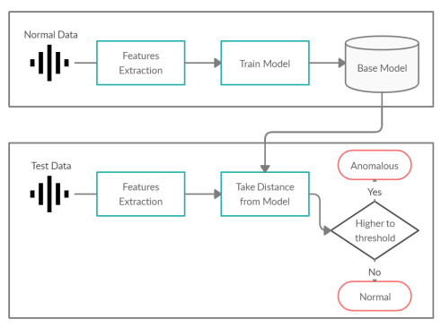
Introduction
01
Anomalous Sound Detection (ASD)
To identify whether the sound emitted from a target machine is normal or anomalous.
Used for audio monitoring system including public surveillance, animal husbandry, and factory maintenance.
Unsupervised ASD : Only use normal data for training.
Flow of Unsupervised ASD

Slide 5
02
System model

Slide 6
System model
02
This method is to train an autoencoder (AE) with only normal sound data and detect anomalies based on anomaly scores.
With an encoder for data compression to preserve the most important features and a decoder for original data reconstruction.
(s[t]: discrete time domain audio signal, Xk: frequency-domain acoustic features)
Notes:
The discrete time domain audio signal s[t] is split into short-time frames sk (k is the frame index )

Slide 7
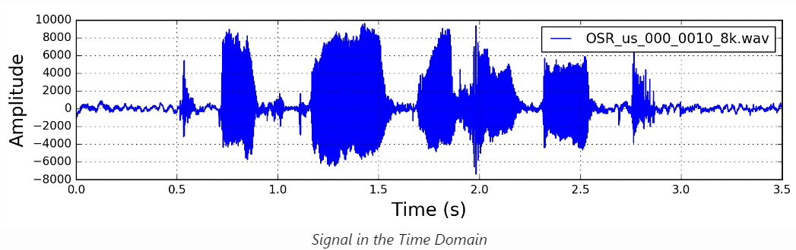
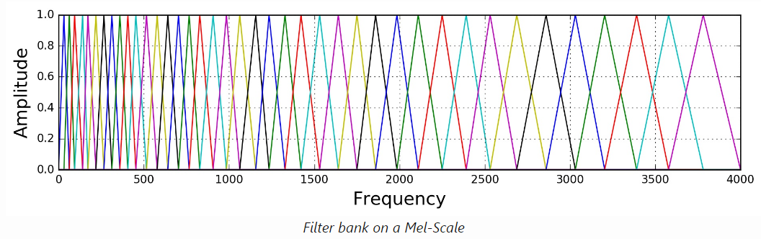
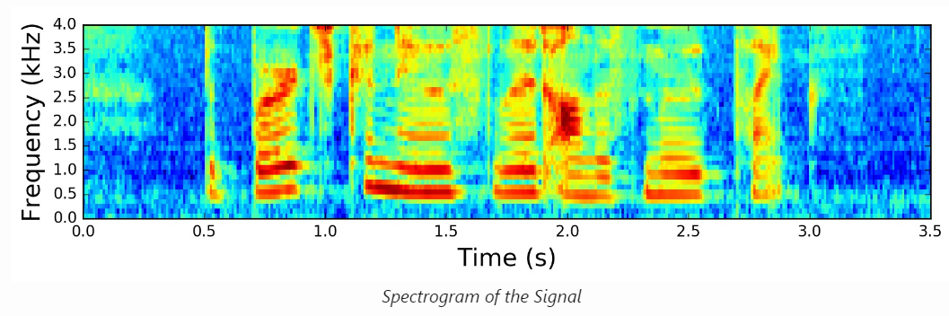
Feature extraction
02
Mel filter banks (MFBs)
The Mel-scale aims to mimic the non-linear human ear perception of sound, by being more discriminative at lower frequencies and less discriminative at higher frequencies.
Mel filters is triangular filters, the number of filters (M) is typically 40.
Notes:
The frequency-domain acoustic features of each frame $x_{k}∈R^{M}$ is calculated by the feature extraction, where Mel filter banks (MFBs) are applied with M Mel filters.
reference: https://haythamfayek.com/2016/04/21/speech-processing-for-machine-learning.html

Slide 8
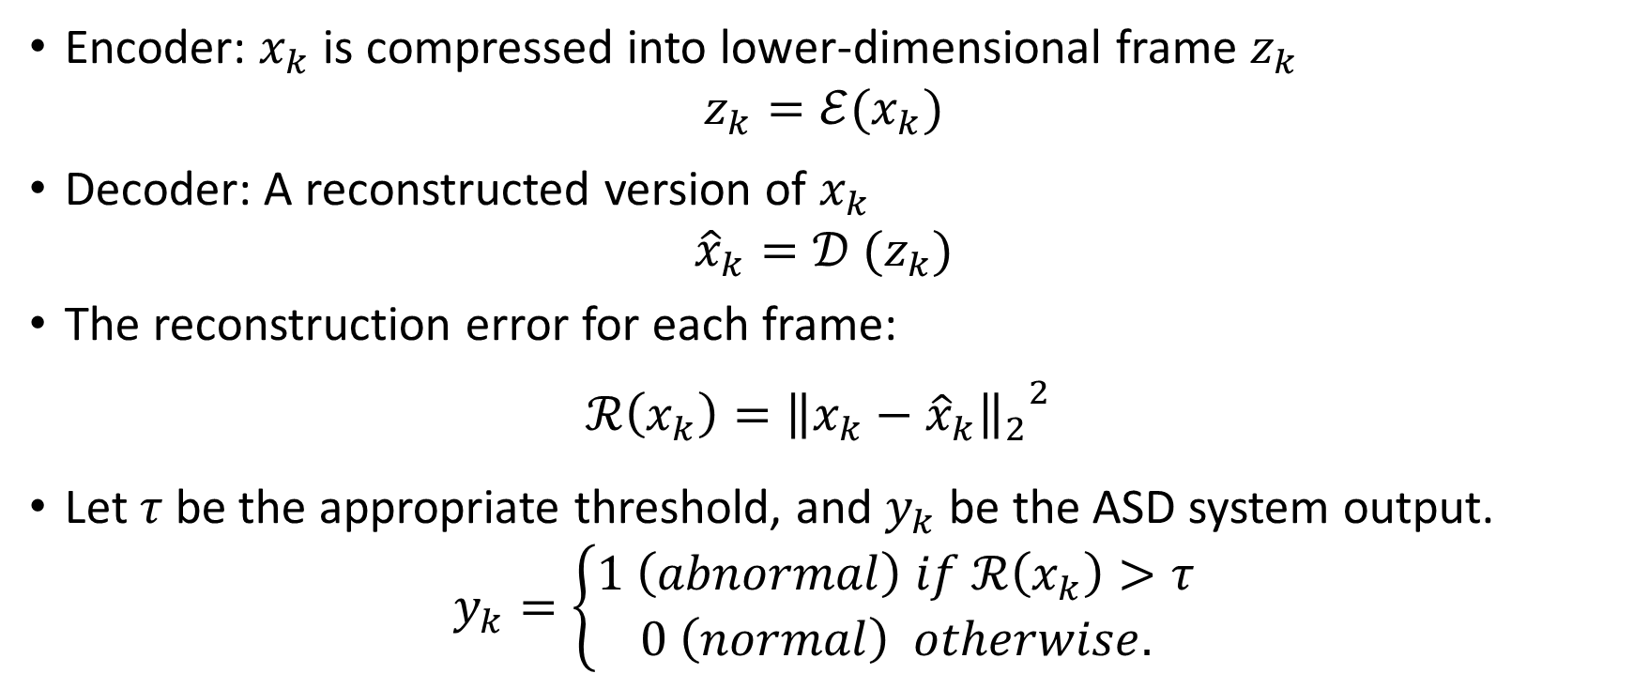
System model
02
Encoder: $x_{k}$ is compressed into lower-dimensional frame $z_{k}$
$$z_{k}=ℰ(x_{k})$$
Decoder: A reconstructed version of $x_{k}$
$${\hat{x}}_{k}=𝒟 (z_{k})$$
The reconstruction error for each frame:
$$ℛ\left(x_{k}\right)={{\left\|x_{k}−{\hat{x}}_{k}\right\|}_{2}}^{2}$$
Let$τ$ be the appropriate threshold, and $y_{k}$ be the ASD system output.
$$y_{k}=\left\{\begin{aligned}1 \left(abnormal\right) if ℛ\left(x_{k}\right)>τ \\ 0 \left(normal\right) otherwise.\end{aligned}\right.$$
Notes:
The optimum value of threshold can be found during training phase where all xk are drawn from normal audio signals.

Slide 9
03
Autoencoder-based approaches

Slide 10
AE (Fully-connected Autoencoder)
03
The AE is trained to minimize the reconstruction error of the normal training sound.
Drawbacks of conventional AE model:
Processing piecewise data without considering other data information such as distribution.
The model is very likely to be overfitted because the AE is to reduce the reconstruction error as low as possible.

Slide 11
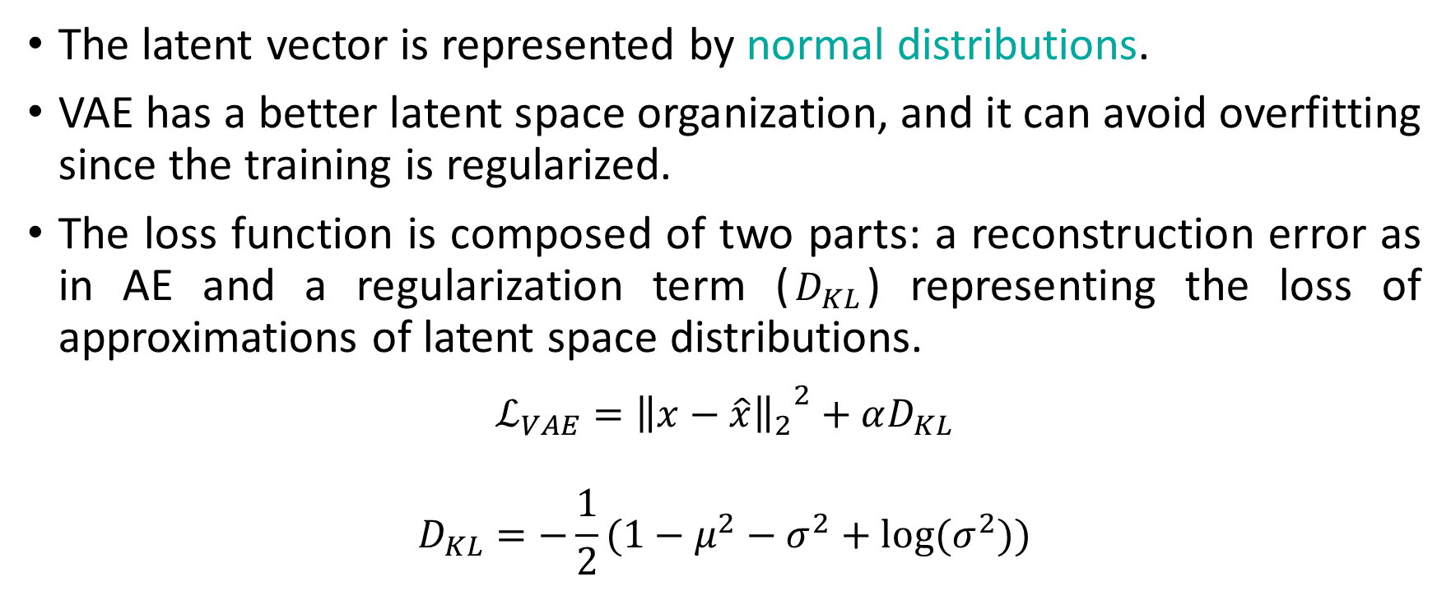
VAE (Variational Autoencoder)
03
The latent vector is represented by normal distributions.
VAE has a better latent space organization, and it can avoid overfitting since the training is regularized.
The loss function is composed of two parts: a reconstruction error as in AE and a regularization term ($D_{KL}$) representing the loss of approximations of latent space distributions.
$$ℒ_{VAE}={{\left\|x−\hat{x}\right\|}_{2}}^{2}+αD_{KL}$$
$$D_{KL}=−\frac{1}{2}(1−μ^{2}−σ^{2}+log⁡(σ^{2}))$$
Notes:
DKL measures the Kullback-Leibler divergence between the approximation of Gaussian distribution N(m, a2) and the standard Gaussian distribution N(0,1)
$μ$ and$σ$ are the expectation and the standard deviation of the Gaussian distribution N ($μ$ ,$σ$2)
$α$ is a hyperparameter

Slide 12
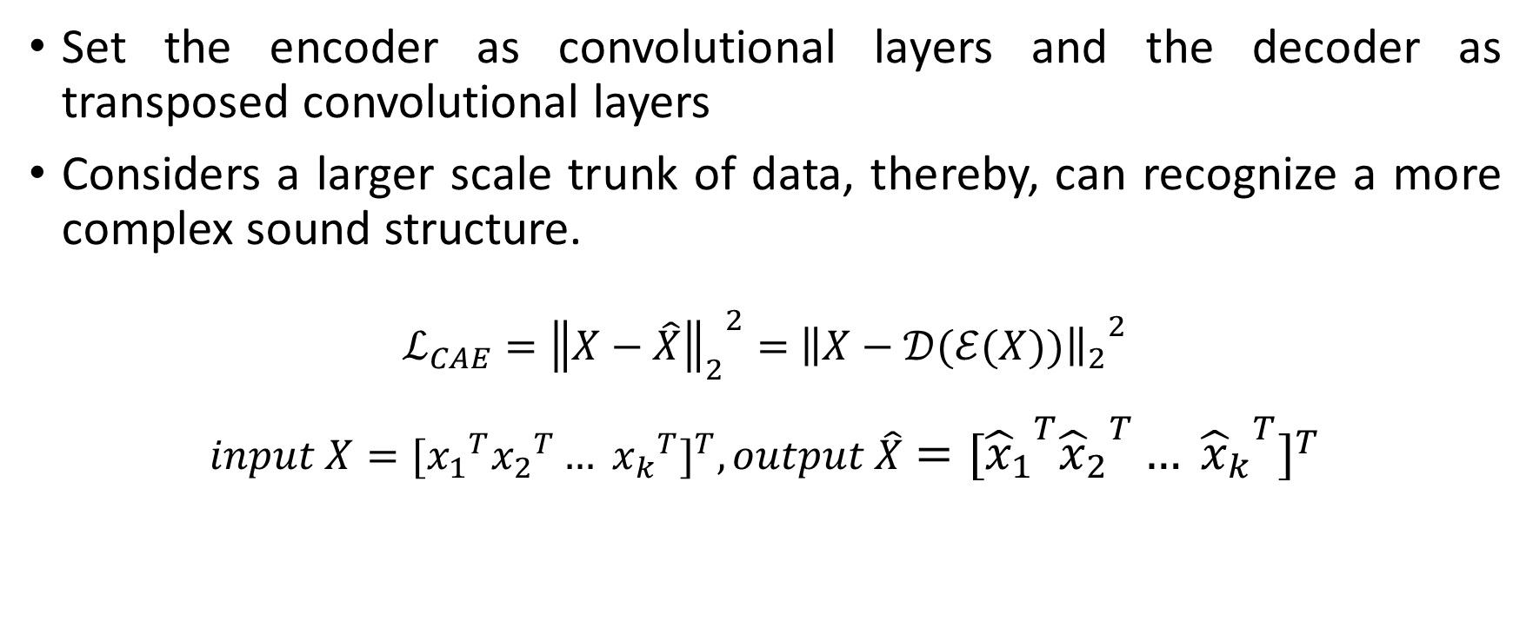
CAE (Convolutional Autoencoder)
03
Set the encoder as convolutional layers and the decoder as transposed convolutional layers
Considers a larger scale trunk of data, thereby, can recognize a more complex sound structure.
$ℒ_{CAE}={{\left\|X−\hat{X}\right\|}_{2}}^{2}=$ ${{\left\|X−𝒟(ℰ(X))\right\|}_{2}}^{2}$
$$input X={[{x_{1}}^{T}{x_{2}}^{T}… {x_{k}}^{T}]}^{T}, output \hat{X}={[{{\hat{x}}_{1}}^{T}{{\hat{x}}_{2}}^{T}… {{\hat{x}}_{k}}^{T}]}^{T}$$
Notes:
Assuming that the audio data have many streams and each stream can be converted to K pieces of MFB of size M , The inputs to the CAE can be considered as K x M images.
k is the frame index

Slide 13
CVAE (CAE + VAE)
03
CVAE is a combination of CAE and VAE, hence the model can get the advantages of both CAE and VAE.
It is constructed by placing a fully-connected VAE (FC VAE), between the encoder and the decoder of the CAE.
Notes:
The input image X is fed into the convolutional layers of the encoder and produce output of dimensions Kh, Mh, Dh.
(Kh: the number of time frames, , Mh: the number of acoustic features, Dh: the number of layer channels)
2. After being permuted and reshaped, the returned data frames have dimension of Kh, Mh x Dh.
3. The TimeDistributed wrapper applies the FC VAE to every frame.
4. The output of the TimeDistributed wrapper is reshaped, permuted and then fed into the decoder of the CVAE to return estimated image X.

Slide 14
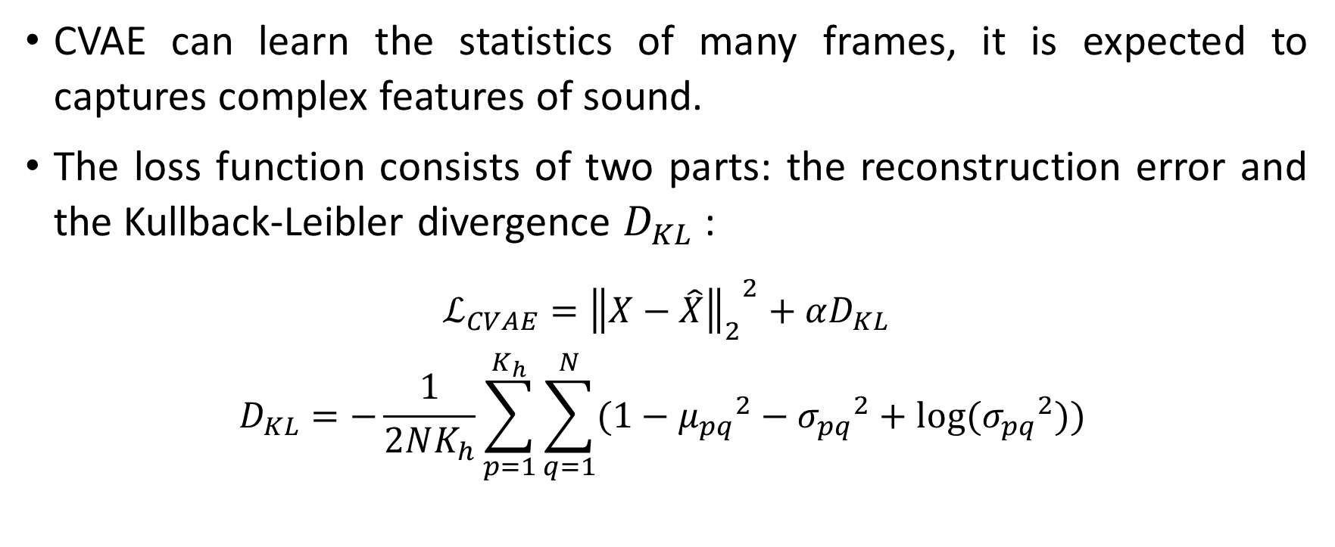
CVAE (CAE + VAE)
03
CVAE can learn the statistics of many frames, it is expected to captures complex features of sound.
The loss function consists of two parts: the reconstruction error and the Kullback-Leibler divergence $D_{KL}$:
$$ℒ_{CVAE}={{\left\|X−\hat{X}\right\|}_{2}}^{2}+αD_{KL}$$
$$D_{KL}=−\frac{1}{2NK_{h}}\sum_{p=1}^{K_{h}}{\sum_{q=1}^{N}{(1−{μ_{pq}}^{2}−{σ_{pq}}^{2}+log⁡({σ_{pq}}^{2})) }}$$
Notes:
N: batch size
$α$ is a hyperparameter

Slide 15
04
Experiments
&
Results

Slide 16
Dataset
04
MIMII dataset
This dataset comprises normal and anomalous sound segments from four industrial machine.
Types: fan, pump, slider and valve. (ID 00, ID 02, ID 04 and ID 06)
Testing set: Composed of all anomalous segments and the same number of normal segments.
Training set: The rest of normal segments.
Notes:
The sampling rate is 16 kHz and each sound segment is 10-second long.
Different levels of signal-to-noise ratio (SNR) of factory noise are also considered, including -6 dB, 0 dB and 6 dB.
there are various anomalous sound scenarios are recorded, such as contamination, leakage, clogging, voltage change, rotating unbalance, rail damage,

Slide 17
Experimental setup
04
AE
FC (32)
VAE
FC (32)
CAE
Conv2D(32)
Conv2D(32)
CVAE
FC (8)
FC (4)
FC (2)
FC (4)
FC (8)
FC (16)
FC (32)
FC (64)
FC (16)
FC (16)
FC (8)
FC (4)
Two Gaussian approximations
FC (4)
FC (8)
FC (16)
FC (32)
FC (64)
Conv2D(32)
Conv2DTransposed(32)
Conv2DTransposed(32)
Conv2DTransposed(32)
Conv2D(32)
Conv2D(32)
Conv2D(32)
Conv2DTransposed(32)
Conv2DTransposed(32)
Conv2DTransposed(32)
Conv2D(1)
FC (32)
FC (16)
Two Gaussian approximations
FC (16)
FC (32)
FC (64)
Conv2DTransposed(1)

Slide 18
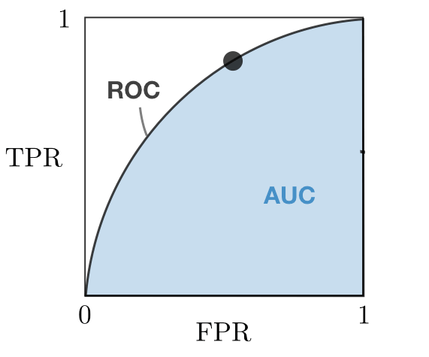
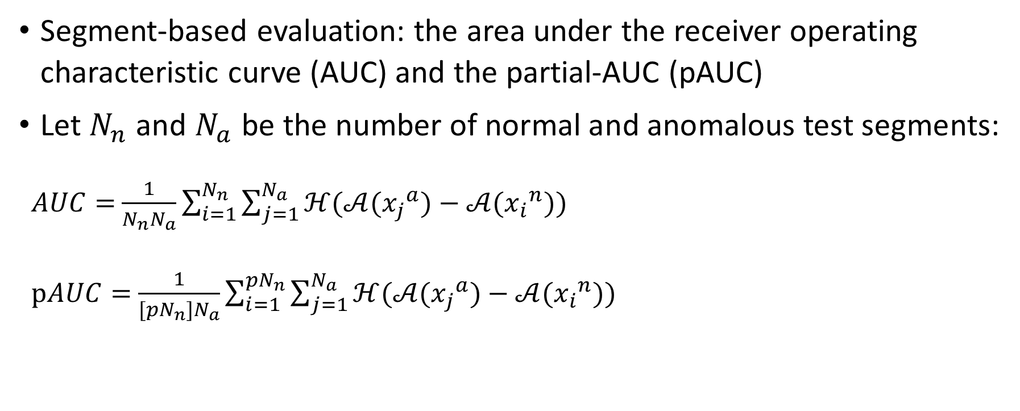
Metrics
04
Segment-based evaluation: the area under the receiver operating characteristic curve (AUC) and the partial-AUC (pAUC)
Let $N_{n}$ and $N_{a}$ be the number of normal and anomalous test segments:
$AUC=$ $\frac{1}{N_{n}N_{a}}\sum_{i=1}^{N_{n}}{\sum_{j=1}^{N_{a}}{ℋ(𝒜({x_{j}}^{a})−𝒜({x_{i}}^{n})) }}$
$pAUC=$ $\frac{1}{{[pN}_{n}]N_{a}}\sum_{i=1}^{{pN}_{n}}{\sum_{j=1}^{N_{a}}{ℋ(𝒜({x_{j}}^{a})−𝒜({x_{i}}^{n})) }}$
Notes:
The pAUC is introduced to increase the true positive rate (TPR) under low false positive rate (FPR) conditions, hence it is calculated as the AUC over a low FPR range [0, p].
In this work, p is set to 0.1.

Slide 19
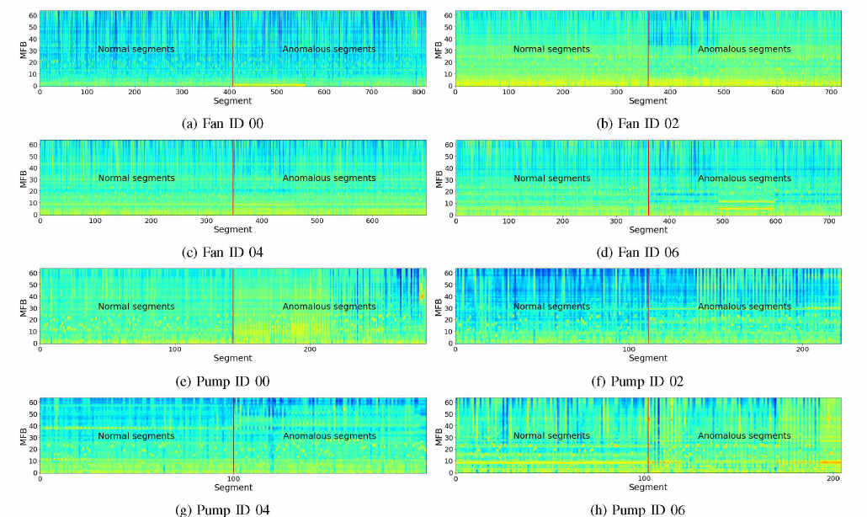
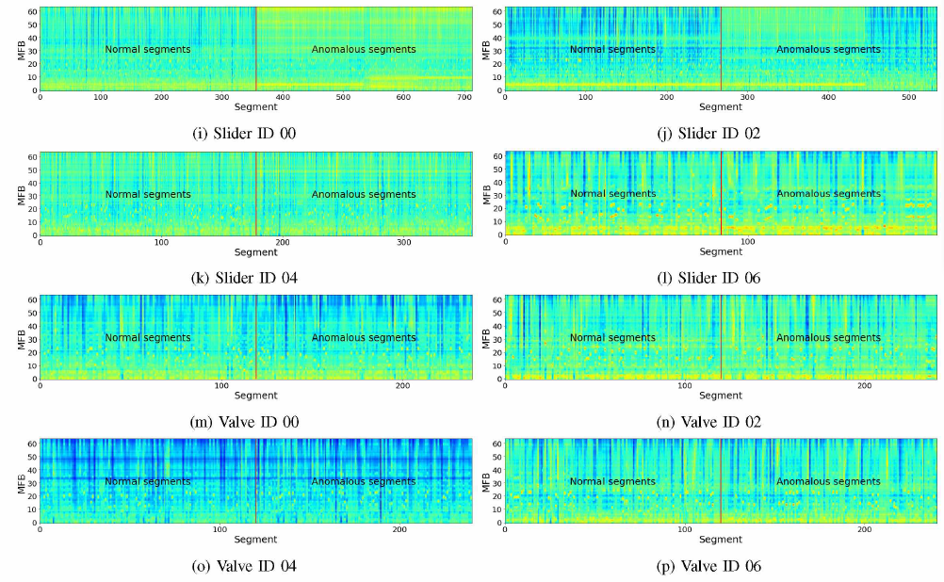
Results
04
MFB spectrograms of test samples for all machines at -6 dB SNR
Notes:
Sound characteristics of all machines are different from each other.
(框起來的)Similar MFB features of normal and abnormal segments - difficult to distinguish anomalies from normal samples
Different MFB features of normal and abnormal segments – easier to detect anomalies for these machine IDs.
(MFBs of fans are relatively stationary over time. The valve sound is much more non-stationary, so that the reconstruction of the valve sound is really an awkward task.)

Slide 20
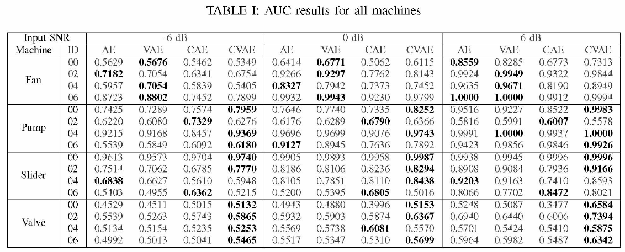
Results - AUC
04
Notes:
For the fan IDs regardless of SNR, two simple methods AE and VAE show higher AUCs compared to the CAE and the CVAE.
For the remaining machine IDs, the proposed CVAE outperforms other methods, except for some certain cases.

Slide 21
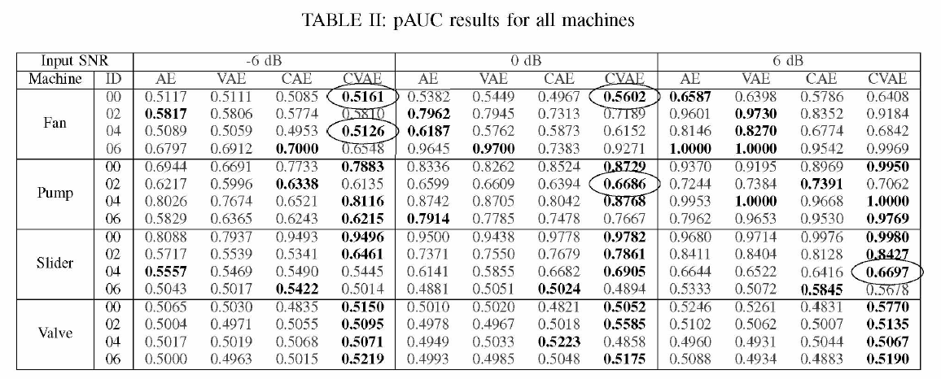
Results - pAUC
04
Notes:
(圈起來的) For a few specific machine IDs, the CVAE outperforms other models in terms of pAUC although its AUCs do not show the best performance.
The AE and the VAE are no longer best effective approaches for the fans at all SNR levels.

Slide 22
Results summary
04
The pAUC metric restricts the ASD system from giving false anomaly alerts, so it can evaluate the anomaly detection performance more effectively than AUC metric. If a model presents the best AUC, it does not mean it also provides the best pAUC.
MFBs of fans are relatively stationary over time, thus the frame-based models AE and VAE would be more suitable than segment-based models CAE and CVAE

Slide 23
Results summary
04
The proposed CVAE shows the best result for almost machines.
This ASD task is evaluated based on sound segments, not sound frames. The CVAE reconstructs input features segment by segment, hence it can discriminate between normal and anomalous segments more accurately than FC models which are only able of frame reconstruction.
The FC VAE with Gaussian approximations makes the CVAE both keep significant acoustic features and ensure that the latent space regularity is more general. Therefore, the CVAE can reduce the number of false detected anomalies.

Slide 24
05
Conclusion

Slide 25
Conclusion
05
This paper examine the CVAE for the ASD task of industrial machine sound and compare its performance to three conventional methods including AE, VAE and CAE.
The experimental results indicate that the proposed CVAE outperforms the rest for nearly all machines.
For time stationary machine sound signals, the use of fully-connected models yields better performance in comparison with convolutional models.
It is still a challenge to reconstruct non-stationary sound as well as detect anomalies for this type of sound.

Slide 26
Deep Convolutional Variational Autoencoder for Anomalous Sound Detection
Final Project Proposal

Slide 27
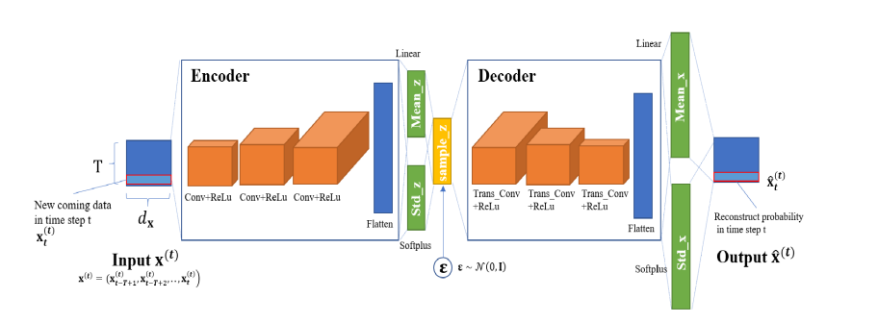
Convolutional VAE
05
Implement the Convolutional VAE and compare with paper result
Reference: https://ieeexplore.ieee.org/stamp/stamp.jsp?arnumber=9023488

Slide 28
Deep Convolutional Variational Autoencoder for Anomalous Sound Detection
Q & A

